Slide 1
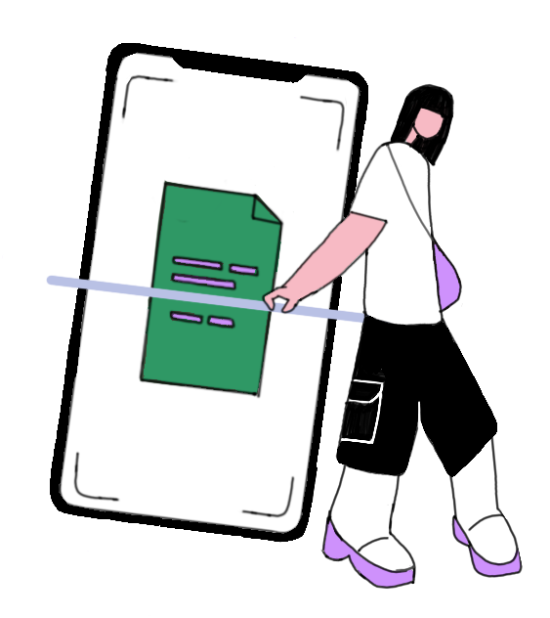

Helvetica
Hiragino Kaku Gothic Std
Full name
Full name
Full name
Full name
Full name
Email Address
Email Address
Email Address
Email Address
Email Address
Password
Password
Password
Password
Password
Confirm Password
Confirm Password
Confirm Password
Confirm Password
Confirm Password
Sign Up
Sign Up
Sign Up
Sign Up
Sign Up

Slide 2
landing
Learn how it works
Home/
summary
scan
documents
account

Slide 3
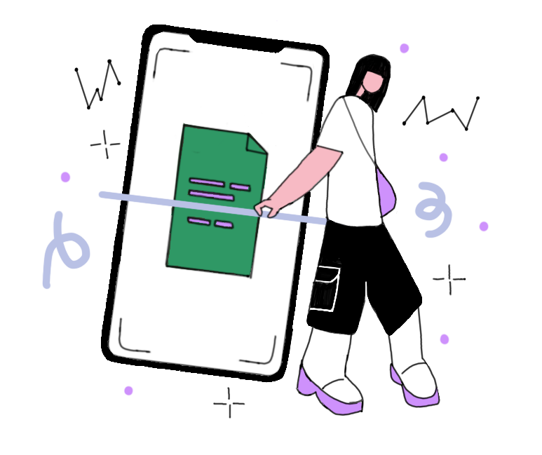
Full name
Email Address
Please enter your verification code
Email Address
Change your password
We have sent a verification code to your registered
email ID
Password
Password
Please enter your email
Make everyday
count with
Tax OCR
Confirm Password
Confirm Password
Forgot Password?
resend
Log in
next
next
done
Create account
Sign Up
Sign Up
Sign Up
Already have an account? Log in
Already have an account? Log in
Don’t have an account? Sign up

Slide 4
Full name
Email Address
Please enter your verification code
Email Address
Change your password
We have sent a verification code to your registered
email ID
Password
Password
Please enter your email
Make everyday
count with
Tax OCR
Confirm Password
Confirm Password
Forgot Password?
resend
Create Account
Log in
next
next
done
Sign Up
Already have an account? Log in
Already have an account? Log in
Don’t have an account? Sign up

Slide 5
Full name
Email Address
Please enter your verification code
Email Address
Change your password
We have sent a verification code to your registered
email ID
Password
Password
Please enter your email
Make everyday
count with
Tax OCR
Confirm Password
Confirm Password
Forgot Password?
resend
Create Account
Log in
next
next
done
Sign up
Already have an account? Log in
Already have an account? Log in
Don’t have an account? Sign up

Slide 6
Full name
Full name
Full name
Full name
Full name
Full name
Email Address
Email Address
Email Address
Email Address
Email Address
Email Address
Password
Password
Password
Password
Password
Password
Confirm Password
Confirm Password
Confirm Password
Confirm Password
Confirm Password
Confirm Password
Create Account
Create Account
Create Account
Create Account
Create Account
Create Account
Already have an account? Log in
Already have an account? Log in
Already have an account? Log in

